Slide 1



A snapshot of the IMF’s policy and operational work on inequality
Stefania Fabrizio
Deputy Unit Chief
International Monetary Fund
September 2017
November 15, 2016

Slide 2

Why Does the IMF Focus on Inequality?
  High levels of inequality can be destructive to the level and durability of growth
  Growth- and stabilization-centric macroeconomic and structural policies have an impact on inequality
  Growing interest from membership

Slide 3
IMF’s Engagement with Countries
1. Analytical Work
Bilateral policy advice has benefitted from cross-country work
2. Policy Advice
3. Capacity Development

Slide 4
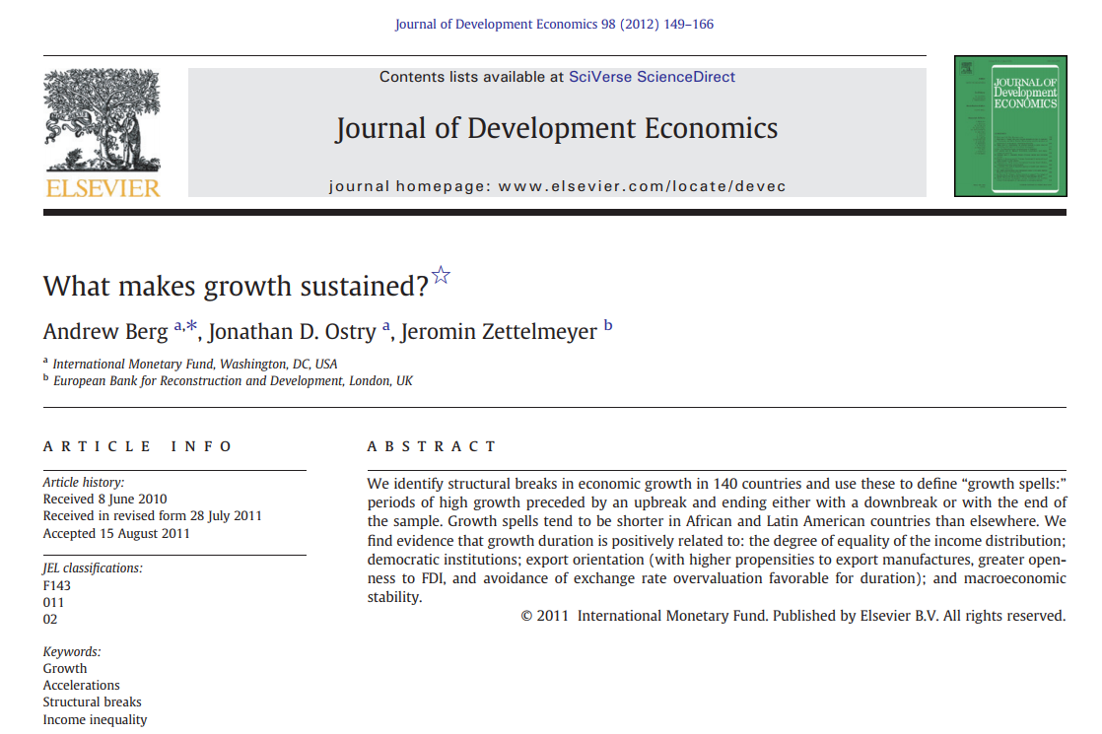
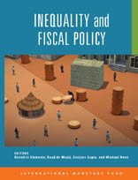
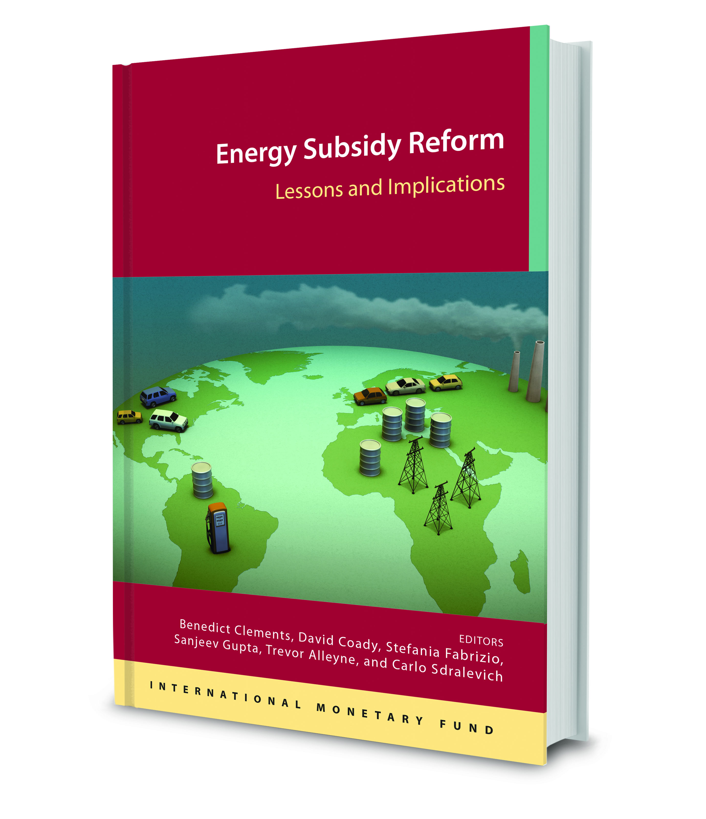
Analytical Work: Some Examples
October 2017 Fiscal Monitor

Slide 5
IMF’s Engagement with Countries
1. Analytical Work
Pilots to explore how best to add value for the membership
2. Policy Advice
3. Capacity Development

Slide 6
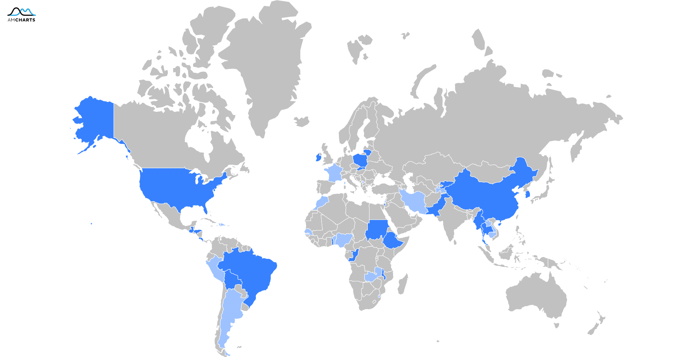
Policy Advice: Pilot Initiative
Inequality Case Studies: Completed
Inequality Case Studies: Ongoing
Notes:
Two waves: 24 done 2 to go
New wave: 16

Slide 7
Focus and Topics
  Comparative analysis of inequality and poverty
  Income polarization
  Growth inclusiveness
  Expenditure composition
  Subsidy reform
  Tax progressivity
  Financial inclusion
  Rural poverty
  Regional income inequalities
  Labor market duality
  Assessment of reform options
  Impact of commodities boom-bust cycles
  Social protection assessment

Slide 8
Methodological approaches
  In-house tools:
  Model-based framework for assessing economic and distributional impact of policies (Bolivia, Brazil, Republic of Congo, Dominica, Ethiopia, Guatemala, Honduras, Malawi, Myanmar, Uganda, United States; in the pipeline Argentina, Benin, Morocco, Senegal)
  Toolkit for incidence analysis of subsidy reform (Technical assistance: e.g. Brunei, Mali; training: Kuwait center; online course/manual)
  Other tools:
  Lustig/Gates Foundation's toolkit for incidence analysis of fiscal policy (several AFR countries)

Slide 9
Country examples

Slide 10

Poland – Economic Growth
Per-capita income is notably lower in the east,…
… where labor productivity is also lower.
GDP per Capita, 2014 1/
(Percent of EU28 average, PPS-adjusted)
Labor Productivity, 2012
(Percent of average in Poland)
+1.2
+0.85
+0.24
+0.56
-7
-0.6
 | below 55
 | 55 - 65
 | 65 - 75
 | 75 - 85
 | above 85
 | below 70
 | 70 - 90
 | 90 - 110
 | 110 - 130
 | above 130
Notes:
Although Poland has enjoyed strong growth and steady income convergence with the EU over the last two decades, important disparities persist at the regional level. Per-capita income is higher in the west—which is integrated into the German supply chain and enjoys higher levels of FDI—than in the east— where the economy is more reliant on less productive agriculture. Despite strong overall growth, the east has not been catching up to the west.
Reducing regional disparities by boosting economic performance in lagging regions would promote faster and more inclusive growth. Estimates suggest that Poland’s GDP per capita could be increased by 7 percent if one-third of the gap between regions with GDP per capita below average and the four regions, which are above average, was closed. This would imply an additional 5 percentage point convergence to the EU28 average income level. Boosting labor productivity growth in lagging regions is key to reducing regional disparities. There is a strong association between income per capita and labor productivity levels: wealthier regions in Poland also tend to have higher levels of productivity.
Policies to boost regional productivity convergence would require supporting structural transformation in the east, facilitating labor mobility, and attracting FDI to less productive regions.
• Structural transformation. Productivity growth in the east can be supported by reallocating labor from low-productivity agriculture to higher-productivity industry and service sectors. The subsidized pension scheme for farmers should be gradually phased out to discourage inefficient farming motivated by pension arbitrage. Moving from the current tax system based on farm size and quality of land to an income-based tax would encourage scaling up of farms, increasing their capital intensity and productivity.
• Labor mobility. Active labor market policies to improve job searching efficiency across regions combined with policies to reduce skill mismatches—including by better aligning education and training curricular with employer needs—would facilitate
labor mobility across sectors and regions, and help lower high structural unemployment in the east.
• FDI. Investor surveys suggest that access to skilled labor and good public infrastructure are important for location of new projects. Improving educational attainment and strengthening transportation networks in less productive regions would help in this regard.

Slide 11

Bolivia – Commodity Cycles
Model-Based Decomposition of the Decline in Inequality: the Role of Commodity Price Hike, Acquisition of Labor Skill, and Fiscal Policy
Notes:
FactsAverage 2006-2014 GDP growth was 2.1pp higher than 2000-2005.
Growth acceleration coincides with boom in:
Natural gas’s prices Agricultural commodities.
During the same period of time poverty and inequality decreased.
The Gini coefficient fell by approximately 12 points.
Poverty fell by 20 percentage points.
Energy prices boom (increase of 45%)
Agricultural prices boom (increase of 35%).
Increase in migration from rural to urban areas (rural population fell from 37% in 2000-2005 to 30% in 2006-14)
Reduction in the share of population considered as low skill (from 63 % in 2000-2005 to 52% 2006-2014).
Objective: Quantify the potential macro-distributional impact of commodity price booms in Bolivia. To achieve the objective we compare two distinct periods of time: a pre-boom period (2000-2005) and a commodity price boom period (2006-2014).
Key findings Not all commodity price shocks are equal:
Energy prices: have only an indirect impact on distribution through their impact on:
government revenues/expenditures (i.e., cash transfers, infrastructure, government bill)
production costs of the industrial sector that affect labor demand and urban wages Agricultural prices: have a direct and an indirect impact on income distribution. Direct impact on agricultural incomes affecting inter-sectoral inequality (rural/urban inequality)Indirect impact on urban households through effect on food prices and the general level of prices in the economyThe direct impact of commodity prices account for 31 percent of the reduction in the Gini between the two periods
Additional factors helped reducing inequality between the periods
Changes in the skill level of the labor force - the average share of the labor force considered as low skill went from 62% in the pre-boom period to 51% during the boom period- account for another 31 percent of the reduction in the Gini coefficient
Changes in social spending account for 38 percent of the reduction in the Gini coefficient…, this higher spending was largely possible because of the impact of the commodity price boom on fiscal revenues – royalties revenues more than doubled during the boom period
Commodity price burst represents a challenge for inclusive growth
In the medium term (5 to 7 years) without policy adjustment the bust in commodity prices is expected to:
Reduce annual growth rates by 1.4 pp.
Increase the Gini by 1 point – incomes for the totality of the population fall but incomes for the worse off fall by more. Poverty reduction slows down by 7.8 pp.
Fiscal consolidation + better quality of public investment in infrastructure reduces the negative impact in growth rates to 0.6 pp.Better targeted social transfers can offset the impact of the bust in inequality and poverty: Gini falls 1point instead of increasing 1 point. Poverty reduction slow down is 2.4 pp.

Slide 12






Ethiopia – Financial Sector Reform
Ethiopia: Economic and Distributional Impact
(Cumulative change over 5 years)
Financial Sector Reform
Financial Inclusion
Labor Mobility
+7.2
Cash Transfers
Overall Impact
+8
+5.2
0
+2.2
-3.1
-4.4
-0.3
-1.4
-0.7
-2.8
(Percent)
(Percentage Point)
(Percentage Point)
Notes:
The financial sector in Ethiopia is still underdeveloped and faces important policy distortions, with 60 percent of the market share in the end of the public Commercial Bank of Ethiopia. Interest rates on deposits are below market rates and two-thirds or total credit is channeled to the public sector. Against this backdrop, the reform here considered envisages an increase in the deposit rates to bring them closer to market rates and a reduction of the share of total credit channeled to the public sector.
Simulation results suggest that the reform can boost private sector activity and economic growth. Higher deposit rates would increase private savings, thus augmenting the available pool of resources for banks’ lending activities. Private sector credit would therefore increase, pushing down lending rates and increasing investment and GDP. Credit to the public sector would reduce in terms of total credit but would remain broadly stable in nominal terms.
The reform, however, would likely increase inequality. Given limited financial access, the reform would benefit mostly the manufacturing and modern services sectors, increasing their profitability and wages. Since rural-urban mobility is limited, agricultural workers have little opportunity to shift to higher productivity activities and sectors, exacerbating inter-sector inequality.
If the reform is complemented with measures to increase financial access and sectoral labor mobility the negative distributional impact would be more than off-set.
While addressing labor mobility and financial inclusion takes time, enlarging the existing cash transfer program would help mitigate the negative impact of the financial reform in the short run with only a marginal negative impact on growth.

Slide 13

Malawi – Reform of Agricultural Subdisies
Malawi: Economic and Distributional Impact
(Cumulative change over 5 years)
Agriculture Subsidy Reform
Agriculture Productivity Reform
Cash Transfers
Overall Impact
+4.1
+0.3
+0.9
+1.8
0
-1.4
-0.78
-0.2
-0.07
-3
(Percent)
(Percentage Point)
(Percentage Point)
Notes:
Malawi introduced subsidies to maize fertilizers in 2005 with the objectives to support small farmers, reduce poverty, and address food security problems. However, due to the poor design and targeting of the program, the initiative resulted in an overproduction of maize without addressing food security.
The reform here considered centers on a reduction in the subsidy program, with a view of enhancing productivity and diversification in the agricultural sector.
The reform would reduce incentives to produce maize and induce a more efficient allocation of resources through a shift in production from maize to other higher-value agricultural goods, which would also stimulate exports and growth.
At the same time, the reform would increase inequality. This is because the subsidy system works as a cash transfer, so reducing subsidies would translate into an important reduction of the income of small and poor farmers, exacerbating poverty and inequality. To mitigate the negative distributional impact of the reform, two measures are considered. Cash transfers to the rural poor can help mitigate the impact of the subsidy reform on poverty and inequality in the short run. At the same time, increasing spending for agricultural R&D would also increase the productivity of small farmers, boosting agricultural profitability and income in the medium term.

Slide 14

Stock-taking exercise
Country-level advice for some of the case studies was synthesized into broad policy lessons:
    Pro-growth policies and reforms can have important distributional tradeoffs
    Critical to understand the channels through which tradeoffs may arise
    Need well-designed policy packages that reduce/remove potential tradeoffs

Slide 15
IMF’s Engagement with Countries
1. Analytical Work
Training and tools available to both Fund staff and country authorities
2. Policy Advice
3. Capacity Development

Slide 16
Capacity Building
Workshops and Training
Regular courses on inclusive growth, financial development and inclusion, distributional analysis of subsidy
Technical assistance
Distributional analysis is an integral part of TA on tax and subsidy reforms
Toolkits
Tools for distributional analysis available on the IMF’s website.
Free on-line courses on energy subsidy reform.
Notes:
External Training. Since 2013, more than 800 government officials have benefitted from external training on inclusive growth and financial inclusion—the course is now named Financial Development and Financial Inclusion—especially in the MCD and AFR regions.
Technical Assistance. distributional analysis integral part of expenditure policy missions’ assessment and regularly used to inform recommendations on reform design (such as in the context of tax, energy subsidy and social protection reforms). Recent examples of expenditure policy missions that have used distributional analysis are in the Kyrgyz Republic, Jamaica, Kosovo, Brunei.
Workshops and Training. distributional issues are regularly addressed in energy subsidies reform training. Courses regularly held (in Kuwait and at JVI in Austria)
Toolkits/ On-line resources. (user friendly) tools for distributional analysis in the context of fuel subsidy reforms available on the ‘IMF and Reforming Energy Subsidies’ website (http://www.imf.org/external/np/fad/subsidies/). Free on-line courses on energy subsidy reform available on the edX website. (https://www.edx.org/school/imfx).

Slide 17

Going Forward
New wave of case studies
Internal “how to” note for guiding the operationalization of inequality in surveillance work

Slide 18
THANK YOU

