Slide 1
Growth and Inequality
Jomo Kwame Sundaram
G24 Special Workshop on Growth and Inequality:
Trends and Policy Approaches
Geneva, 6 September 2017

Slide 2
GDP by country income group, 1967-2016

Slide 3
GDP by country income group, 1967-2016

Slide 4
GDP by country income group, 1980-2016

Slide 5
GDP by country income group, 2000-2016

Slide 6
GDP by region, 1967-2016

Slide 7
GDP by region, 1980-2016

Slide 8
GDP by region, 2000-2016

Slide 9
Growth rate by country income group, 1967-2016

Slide 10
Growth rate by country income group, 1980-2016

Slide 11
Growth rate by country income group, 2000-2016

Slide 12
Growth rate by region, 1967-2016

Slide 13
Growth rate by region, 1980-2016

Slide 14
Growth rate by region, 2000-2016

Slide 15
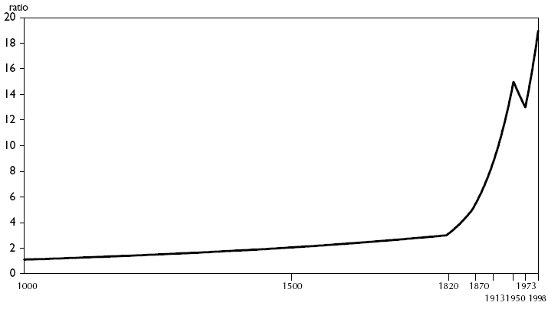
World income inequality increase

Slide 16
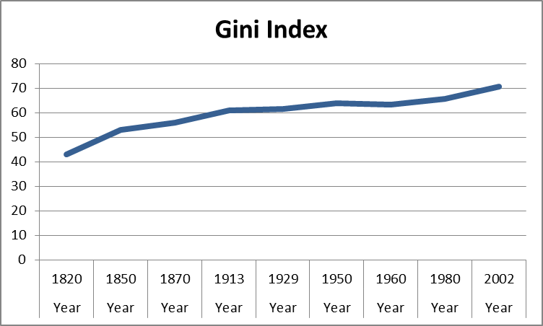
World income inequality increases

Slide 17
2/3s of world inequality due
to international inequalities

Slide 18
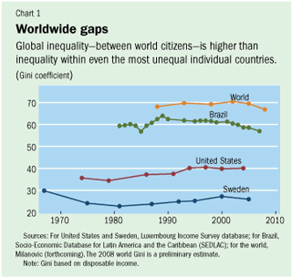
Global > national inequality
Geography > class

Slide 19
Great divergence, 1700-2008

Slide 20
Av. annual growth by income,
1960-80/1980-2000/2000-10

Slide 21
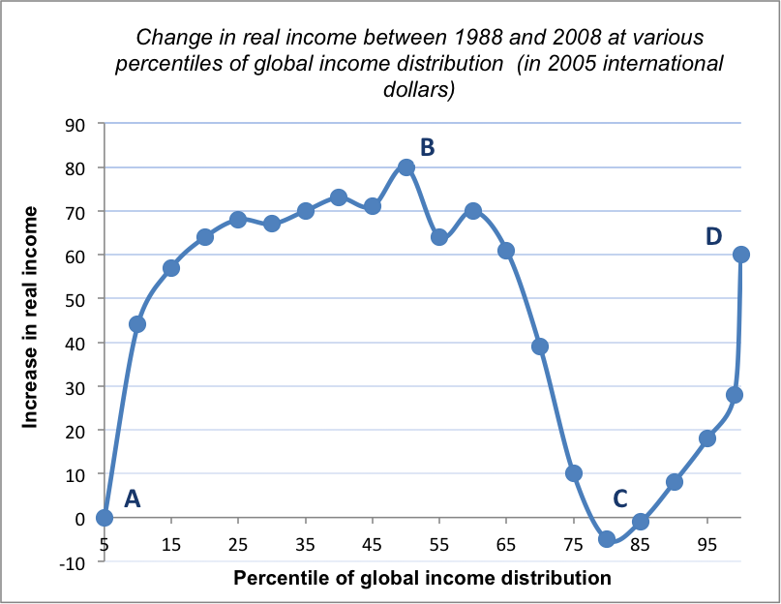
Milanovic elephant

Slide 22
Huge inequalities have increased
Between 20 poorest + 20 richest countries

Slide 23
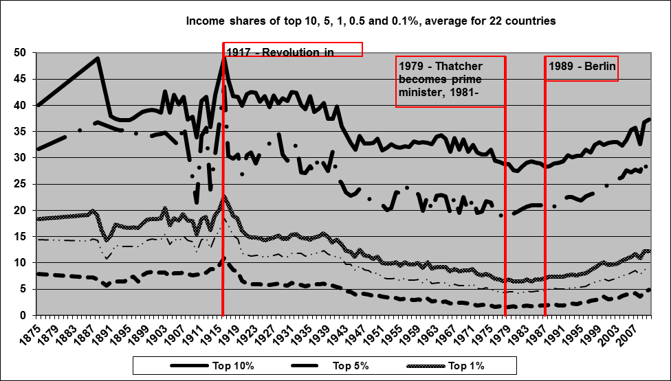
Income shares of top 10, 5, 1, 0.5 and 0.1%, av. for 22 countries
Notes:
Note: European countries: Denmark, France, Germany, Netherlands, Switzerland, UK, Ireland, Norway, Sweden, Finland, Portugal, Spain, Italy; North America: United States and Canada; Australia and New Zealand; Latin America: Argentina; Asia: Japan, India, China, Singapore, Indonesia; Sub-Saharan Africa: South Africa, Mauritius, Tanzania. Overall: about half the population of the world.
Source: Alvaredo, Facundo, Anthony B. Atkinson, Thomas Piketty and Emmanuel Saez (2012). The World Top Incomes Database. 25 April. http://g-mond.parisschoolofeconomics.eu/topincomes.

Slide 24
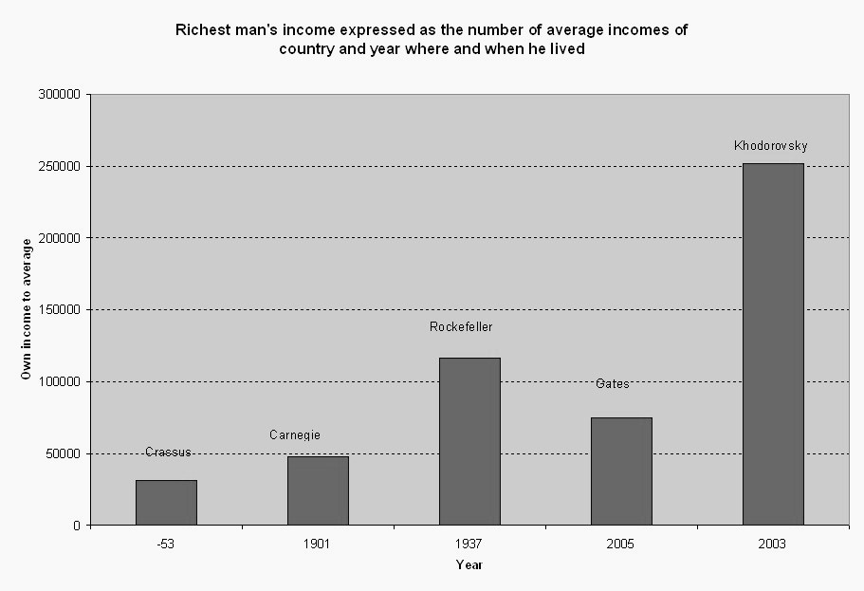
Richest man’s income as multiple of country av. during years when he lived
Notes:
Source: Milanovic, B. The Haves and Have-Nots: A Brief and Idiosyncratic History of Global Inequality. Basic Books, New York, 2011.

Slide 25
Commodity prices decline

Slide 26
South vs North manufactures’ terms of trade

Slide 27
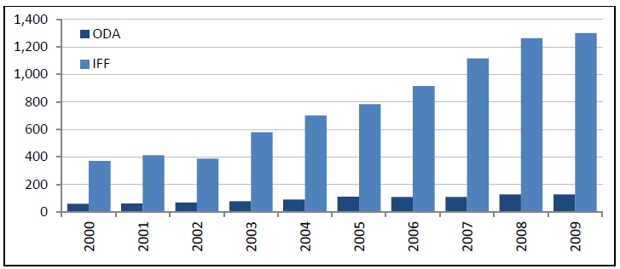
Illicit financial flows vs ODA
Main IFFs due to: (1) trade mispricing; (2) tax evasion
IFFs versus ODA, 2000-09 (billions of current US$)

Slide 28
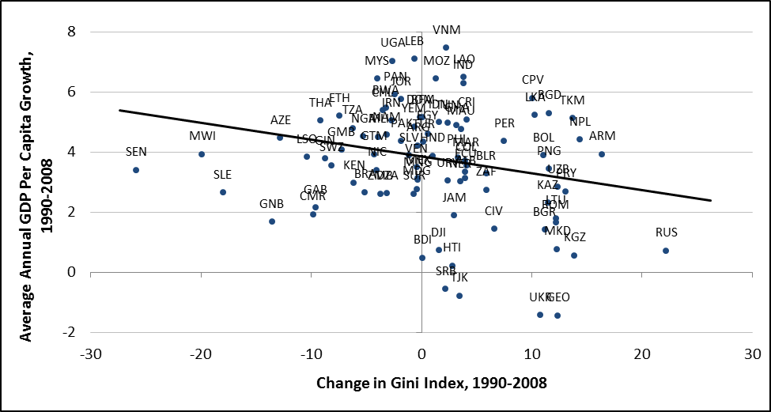

Per Capita Growth + Inequality Change in 94 Developing Countries, 1990-2008
Inequality slows growth
Source: Ortiz and Cummins (2011) UNICEF

Slide 29
Redistribution options
Wages vs property incomes
Property incomes more with IPRs, privatization
Other rents (Porter’s ‘competitive advantage’)
Relative price changes: ToT, QE
Illicit flows: tax evasion, incl. trade mispricing
Fiscal redistribution1: revenue sources, incl. tax
Fiscal redistribution2: spending alternatives
Global public goods? ‘Externalities’?
International taxation
Inclusive growth? Pro-poor: various definitions
Multilateral cooperation?

Slide 30
G24 Program
S1: General and Regional Trends and Perspectives
Resource Dependence and Inequality in Africa:
Impacts, consequences and potential solutions
Drivers of Inequality in the context of the growth-poverty-inequality nexus in Africa
Responding to Income Inequality in Asia
Asia's Income Inequalities
Session 2: Trade, Technology and Labor Markets
Investing in Skills for Inclusive Trade
Exporters, Importers and Employment:
Firm-level evidence from Africa
Exporting, Importing and Wages in Africa:
Evidence from matched employer-employee data
S3: Financial and Monetary Policies
Effects of Monetary Policy Shocks on Inequality
Distributional Effects of Capital Account Liberalization
S4: Fiscal Policies
Composition Effects of Tax-based Consolidations on Income Inequality
Economics of Tobacco and Tobacco Control

Slide 31
Thank you
G24 website:
www.g24.org
IDEAs websites: www.ideaswebsite.org
www.networkideas.org

