Slide 1
gdpcenter.org/TaskForce

Slide 2
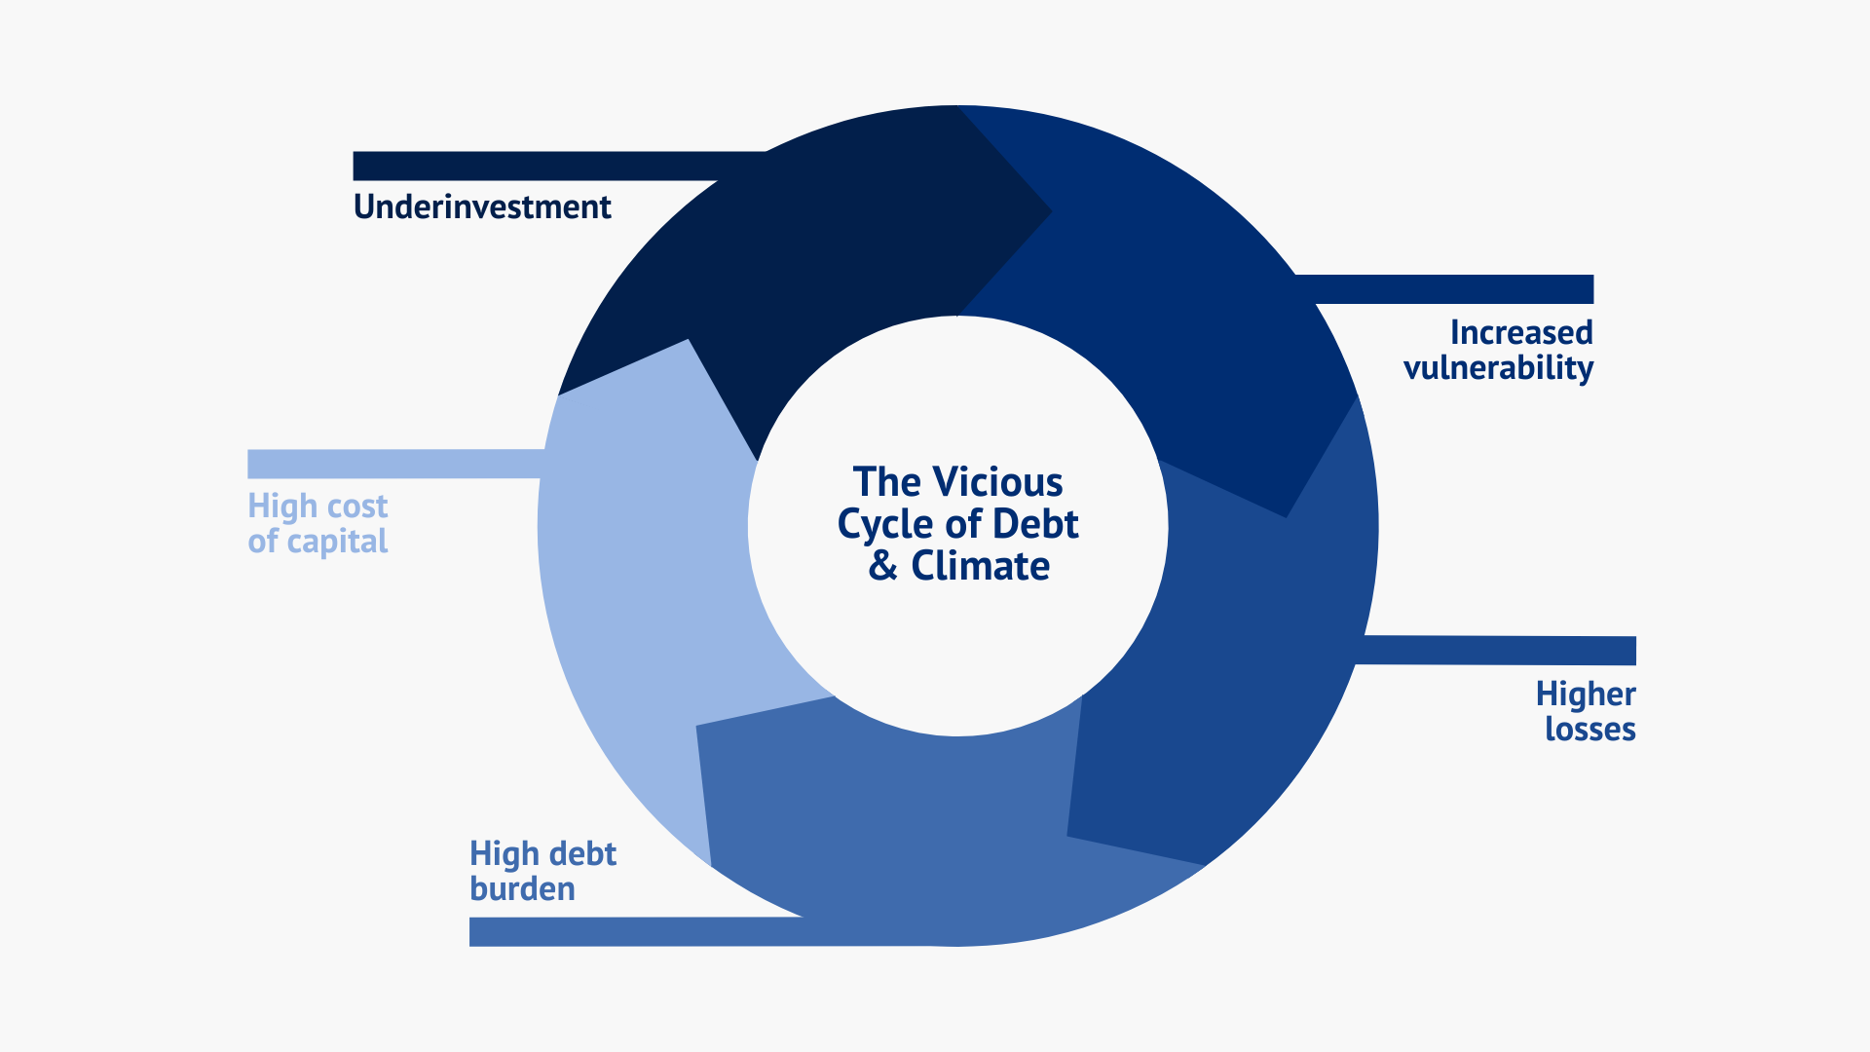

Slide 3
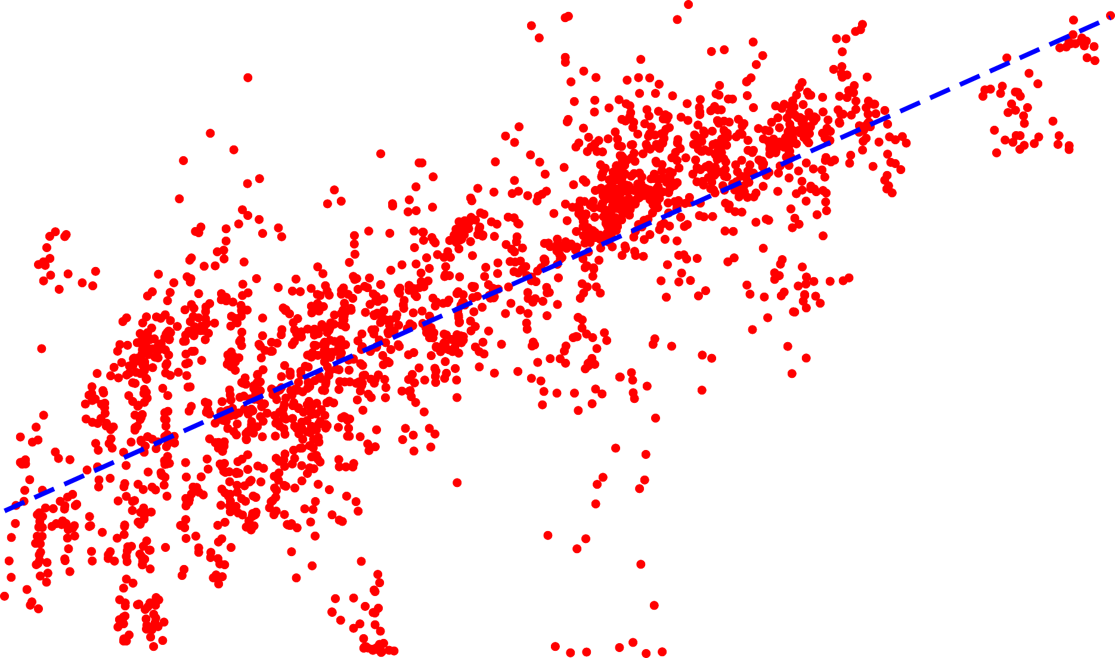
Climate vulnerable countries are going to the IMF for support.
.8
Estimated Probability of IMF Support
.6
..4
.2
0
.3
..4
.5
Vulnerability Index
.6
.7
Source: Maldonado and Gallagher (2023).

Slide 4
The G20 Common Framework isn’t working.
1
Middle income countries are not included. All countries in need of debt relief should have access, especially climate vulnerable economies.
2
Development and climate change needs need to be at the core of sovereign debt restructuring. Debt restructuring should focus on restoring growth and creating the space for development and climate investments to lay the groundwork for sustainable growth.
3
All creditors are not compelled to participate. Common Framework lacks the tools to bring all creditors together for a speedy and timely resolution.

Slide 5
Recommendations
1
Focus on an investment-led approach to a resilient and just transition by bending down the high cost of capital through credit enhancements and concessional finance.
2
Reform the debt architecture so that all climate vulnerable countries in debt distress can obtain timely and necessary debt relief, and deploy better analytical tools analyze climate risks, their macro-critical impacts, and climate investment needs.
3
Scale and reform the IMF lending toolkit to align short- term and longer-run financing horizons without jeopardizing debt sustainability and growth prospects.

Slide 6
Recommendations (cont.)
4
Climate resilient debt clauses. The IMF should make this a standard feature in its agreements. The Catastrophe Containment and Relief Trust also needs to be replenished, scaled up, and opened up to all climate vulnerable economies.
5
Resilience and Sustainability Facility. Expand the use of the RST to issue recovery bonds from debt restructuring exercises; eliminate the requirement to have a concurrent upper credit tranche quality program which unduly restricts access and relax the access norm of 75 percent.
6
Low Income Countries Debt Sustainability Framework review offers an opportunity to integrate climate change shocks and investment needs into the methodology.

Slide 7
gdpcenter.org/TaskForce

