Slide 1
The evolution of public Debt management:
An advisor’s view
G-24 Technical group meeting
Colombo, February 27-28, 2018
Marcelo Giugale
Director
Financial Advisory and Banking

Slide 2
Contents
Who we are
What we used to do for our clients
What we are asked to do today
What we may be asked to do tomorrow

Slide 3
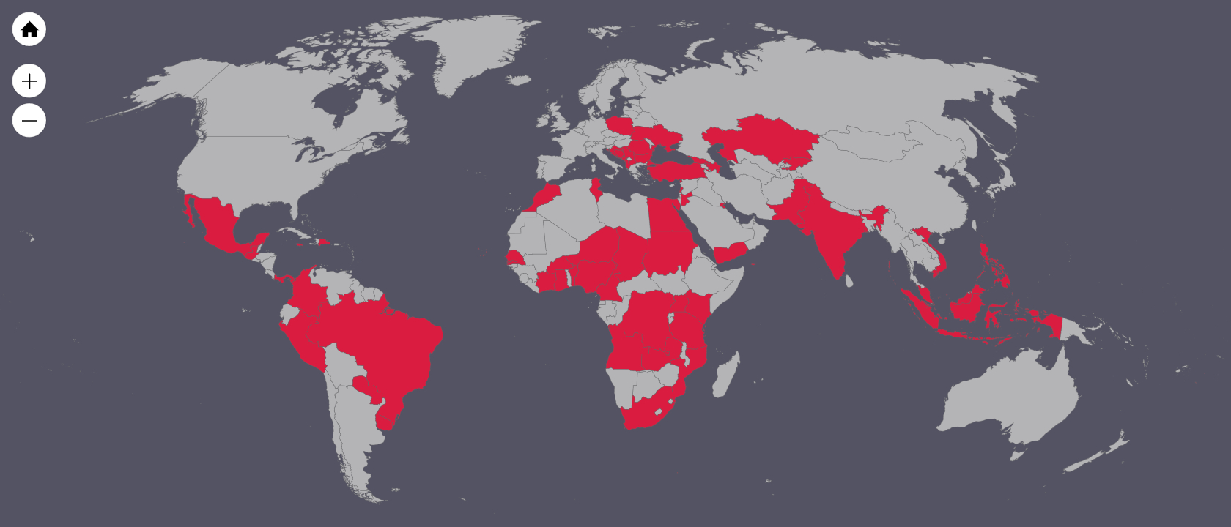
Who we are debt managers away from home
62 countries served in the last 3 years
Notes:
Albania, Angola, Azerbaijan, Barbados, Benin, Bosnia, Brazil, Bulgaria, Burkina Faso, Cabo Verde, Cameroon, Colombia, Cote d’Ivoire, Chad, Croatia, Democratic Republic of Congo, Dominican Republic, Egypt, Gambia, Georgia, Ghana, Guatemala, India, Indonesia, Jamaica, Jordan, Kazakhstan, Kenya, Kuwait, Kyrgyz Republic, Lebanon, Macedonia, Malaysia, Maldives, Mexico (subnationals), Montenegro, Morocco, Mozambique, Niger, Nigeria, Paraguay, Pakistan (central government and subnationals), Panama, Peru, Philippines, Poland, Romania, Senegal, Serbia, South Africa, Sudan, Tanzania, Timor-Leste, Tonga, Tunisia, Turkey, Uganda, Ukraine, Uruguay, Vietnam (central government and subnationals), Yemen, Zambia.

Slide 4
What we used to do for our clients: Life upstream
React to debt crises (LatAm 1980s; Africa 2000s)
Calculate Debt Sustainability & Non-Concessional Limits
Inform the Paris Club Negotiations (with the IMF)
Arrange for Debt Relief (HIPCs + MDRI)
Monitor Debtors’ Performance
Issue Guidelines (with the IMF; first in 2001)
Basic Institutional Development

Slide 5








What we are asked to do today: Life down-stream
Technical Implementation (modelling, buy-backs, etc.)
Contingent Liabilities (the other driver of debt)
Expansion of the Investor Base
Branded Bonds (green, blue, sukuk, etc.)
Insurance (CAT and CAT-like contracts)
Cash Management
Infrastructure Financing

Slide 6
What we may be asked to do tomorrow: Life “side-stream”
Funding Pension Liabilities
Urbanization and Mega-Cities
FinTech, Blockchain, and Cryptos
Climate Change
???

Slide 7
In conclusion…
We have gone from “up-” to “down-” stream
We will go from “down-” to “side-” stream
We will do the whole balance sheet and its risks—”B-RISK”

Slide 8
Thank you!
@Marcelo_WB

Slide 9
Realization of contingent liabilities and its impact on government debt
Average increase in debt/GDP due to materialization of CLs
Debt/GDP
Source: Bova et al (2016), “The Fiscal Costs of Contingent Liabilities: a new dataset”, IMF Working Paper.
Notes:
The recent global financial crisis and the subsequent spike in government debt have highlighted how vulnerable government debt sustainability can be to large shocks. The figure uses event study graphs to show that contingent liability realizations are associated with a significant worsening in the overall fiscal balance, a large increase in debt and a short but steep drop in growth. To obtain these graphs, we regress the variable of interest on a set of period fixed effects while controlling for event fixed effects for our sample of CL realizations. We then plot the coefficients on the period fixed effects five years prior and 10 years after a contingent liability realization. On average, debt increases by over 15 percent of GDP during a CL realization. It rises for roughly three years and then stabilizes, albeit at a higher level than before the CL realization. The overall fiscal balance falls by about 2 percentage points as a share of GDP on average and then stays below the pre-event level for an extended period of time. Lastly, GDP growth drops sharply for two years and then reverts to trend.

Slide 10
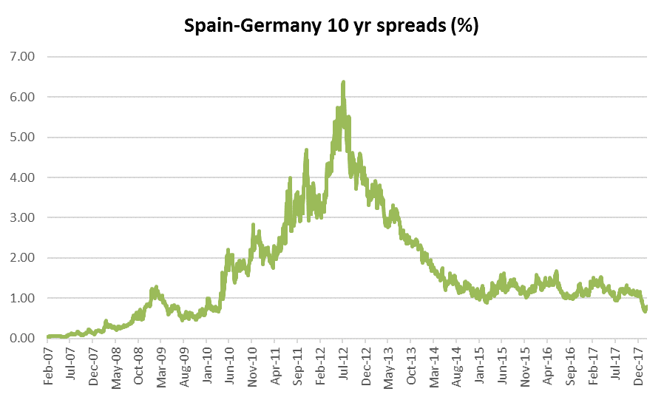
Spain financial sector and subnationals
Source: Bloomberg
Notes:
Spread of 10-year Spanish (government) bonds over 10-year German (government) bonds. The spread reaches almost 6.5% or 650 basis points in July 2012.

Slide 11
Expanding the investor base domestic market development
Strong increase in local currency (LC) over foreign currency (FC) debt
Source: Moody’s
31 largest EM sovereign debt issuers, which represented 91.7% of sovereign EM debt outstanding
Notes:
Moody’s report: “Dramatic rise in local currency sovereign debt issuance reduces emerging market countries’ vulnerability to shocks”.
Sample Coverage
In this study, we review the evolution of sovereign debt over the 2000-14 period, focusing on the development of local currency debt markets and trends in investor participation. Our sample includes the 31 largest emerging market (EM) sovereign debt issuers, which represent 91.7% of sovereign EM debt
Outstanding.
Details of the sample (ratings as of 2015 when the report was released):
Seven issuers in Central and Eastern Europe (CEE):
Czech Republic (A1), Hungary (Ba1), Poland (A2), Russia (Ba1), Slovakia (A2), Turkey (Baa3), Ukraine (Ca).
Seven issuers in Latin America (LatAm):
Argentina (Caa1), Brazil (Baa3), Chile (Aa3), Colombia (Baa2), Mexico (A3), Peru (A3), Venezuela (Caa3).
Nine issuers in Asia (Asia):
China (Aa3), India (Baa3), Indonesia (Baa3), Malaysia (A3), Pakistan (B3), Philippines (Baa2), Sri Lanka (B1), Thailand (Baa1), Vietnam (B1).
Eight issuers in the Middle East and Africa region (ME & Africa):
Egypt (B3), Israel (A1), Lebanon (B2), Morocco (Ba1), Nigeria (Ba3), Qatar (Aa2), South Africa (Baa2), United Arab Emirates (Aa2)

Slide 12
Green bonds annual issuance (USD billions)

Slide 13


Green, Sukuk, Blue and beyond
Profiting for indulgentia
Many debt managers tend to show little enthusiasm for branded bonds
However, such instruments can reach new pools of investors
Green bonds are blooming and attracting private investors
    2008: first issuance (WB)
    2014: green bond indices (S&P, BofA Merrill Lynch, Barclays etc)
    2016: first sovereign
    2017/18: France (EUR 7bi), EM, green sukuk
New instruments are not restricted to branded bonds

